Slide 1
Principles of Programming Language
Amit Dua
Computer Science and Information Systems Department
BITS, Pilani

Slide 2
Lambda Calculus
Lecture slides courtesy Prof. Sriram Rajamani, Prof. Adam Doupe, and Prof. Gabriel Lebec
Lecture material from Reference book titled “Types and programming languages” by Benjamin C. Pierce

Slide 3
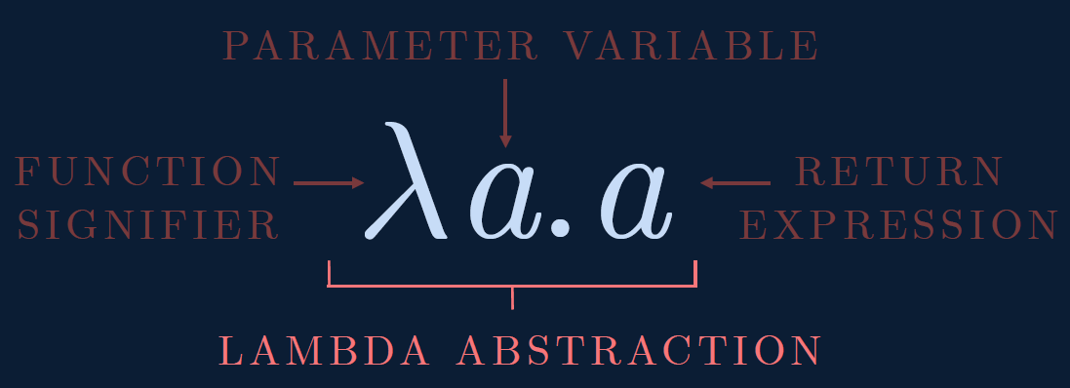

Slide 4
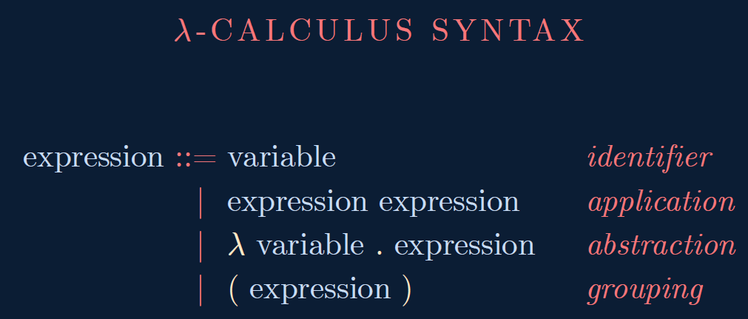

Slide 5
Disambiguation Rules
E → E E is left associative
x y z is
(x y) z
w x y z is
((w x) y) z
λ ID . E extends as far to the right as possible, starting with the λ ID .
λ x . x y is
λ x . (x y)
λ x . λ x . x is
λ x. ( λ x . x)

Slide 6
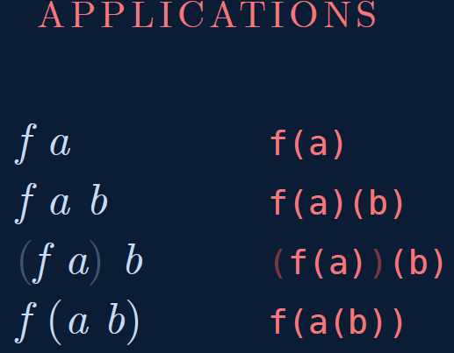

Slide 7
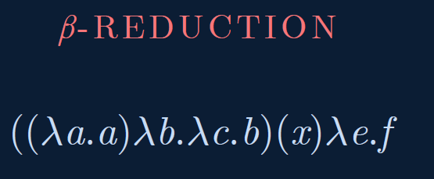

Slide 8
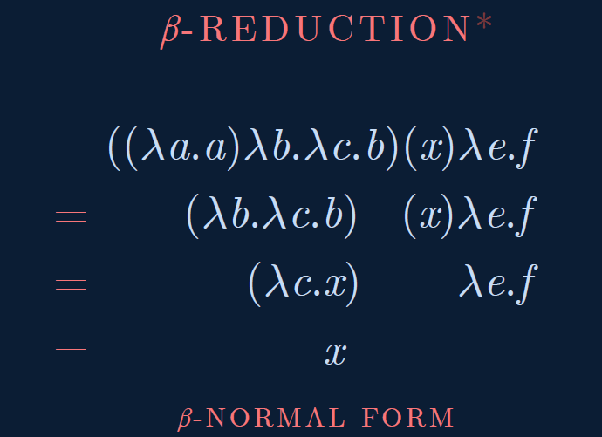

Slide 9
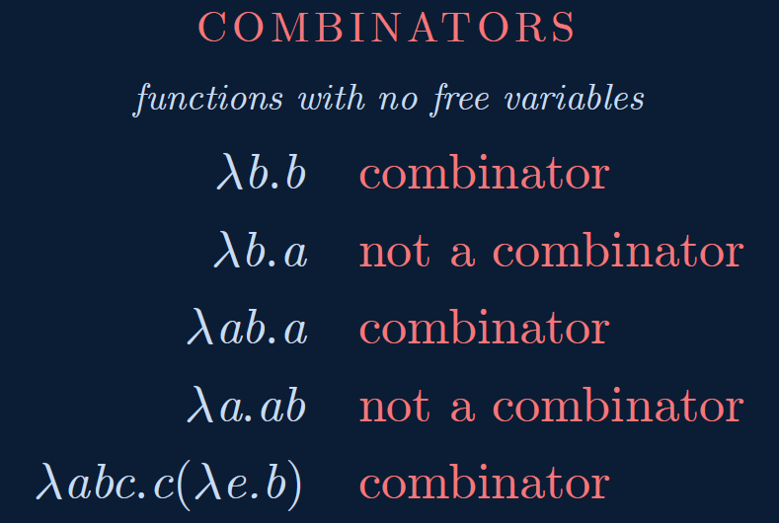

Slide 10
Haskell Example
fType :: Int -> Int -> Int
fType x y = x*x + y*y
main = print (fType 2 4)

Slide 11
Haskell Example
add :: Integer -> Integer -> Integer --function declaration
add x y = x + y --function definition
main = do
putStrLn "The addition of the two numbers is:"
print(add 2 5) --calling a function

Slide 12
Take away from Last couple of classes
New programming language – Lambda calculus
Syntax
Scope
Renaming and Reduction
Call by value and name

Slide 13
Today’s class
How to express
Combinators
Boolean expression
Numbers
addition

Slide 14

Identity Combinator
I := 𝜆a.a
I x = ?
I x = x
I I = ?
I I = I

Slide 15
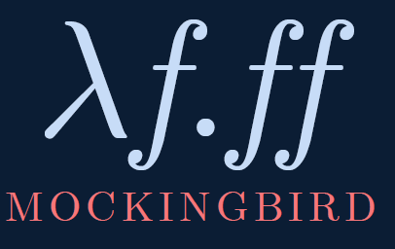
M := 𝜆f.ff
M I = ?
M I = I I = ?
M I = I I = I
M M = ?
M M = M M = ?
// stack overflow

Slide 16
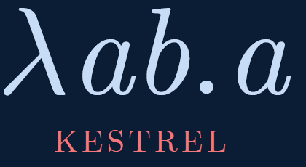
K := 𝜆ab.a
= 𝜆a.𝜆b.a
K M I = ?
K M I = M
K I M = ?
K I M = I
K I x = I
K I x y = I y = y

Slide 17
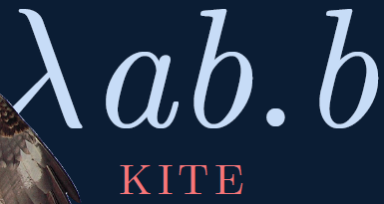
KITE Combinator
KI := 𝜆ab.b
= K I
KI M K = ?
KI M K = K
KI K M = ?
KI K M = M

Slide 18
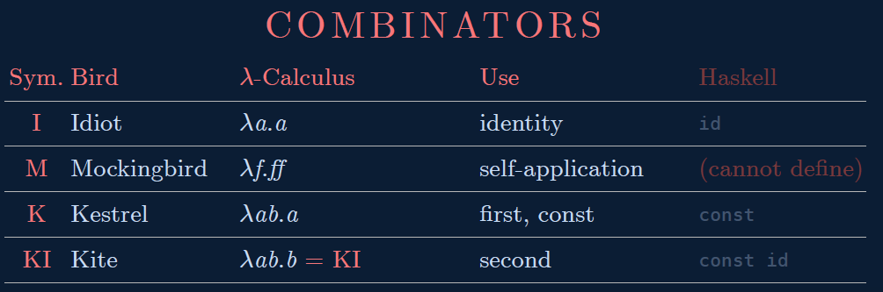

Slide 19
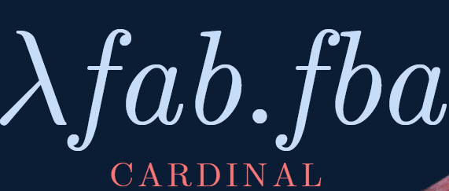
CARDINAL Combinator
C := 𝜆fab.fba
C K I M = ?
C K I M = M

Slide 20
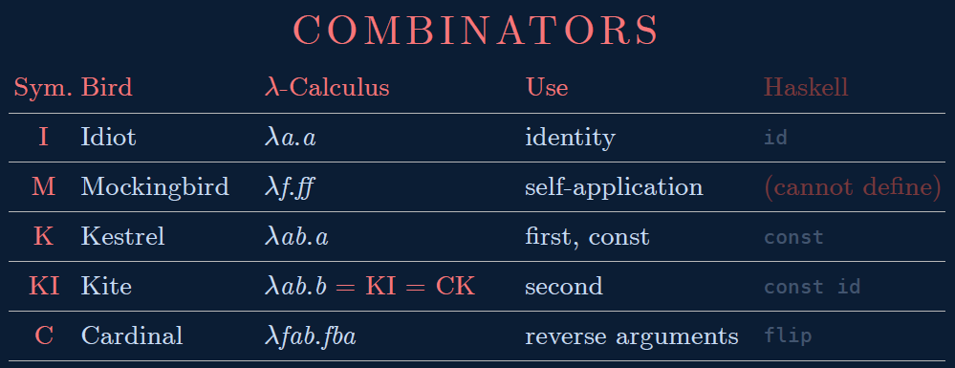

Slide 21
Boolean Logic
T = (λ x . λ y . x)
F = (λ x . λ y . y)
and = (λ a . λ b . a b F)
and T T
(λ a . λ b . a b (λ x . λ y . y))

Slide 22
and T T
(λ a . λ b . a b (λ x . λ y . y)) (λ x . λ y . x) (λ x . λ y . x)
(λ b . a b (λ x . λ y . y))[a →(λ x . λ y . x)] (λ x . λ y . x)
(λ b . (λ x . λ y . x) b (λ x . λ y . y)) (λ x . λ y . x)
((λ x . λ y . x) b (λ x . λ y . y))[b→(λ x . λ y . x)]
(λ x . λ y . x) (λ x . λ y . x) (λ x . λ y . y)
(λ y . x)[x →(λ x . λ y . x)] (λ x . λ y . y)
(λ y . (λ x . λ y . x)) (λ x . λ y . y)
(λ x . λ y . x)[y→(λ x . λ y . y)]
(λ x . λ y . x)
T

Slide 23
and T F
(λ a . λ b . a b F) T F
(λ b . a b F)[a→T] F
(λ b . T b F) F
(T b F)[b→F]
(T F F)
(λ x . λ y . x) F F
(λ y . x)[x→F] F
(λ y . F) F
F[y→F]
F

Slide 24
and F T
(λ a . λ b . a b F) F T
F T F
F

Slide 25
and F F
(λ a . λ b . a b F) F F
F F F
F

Slide 26
not
not T = F
not F = T
not = (λ a . a F T)
not T
(λ a . a F T) T
T F T
F
not F
(λ a . a F T) F
F F T
T

Slide 27
If Branches
if c then
a
else
b
if c a b
if T a b = a
if F a b = b
if = (λ a . a)

Slide 28
Examples
if T a b
(λ a . a) T a b
T a b
a
if F a b
(λ a . a) F a b
F a b
b

Slide 29
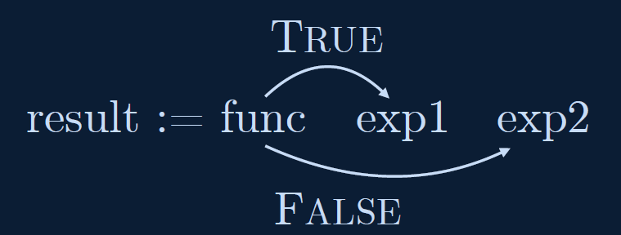
const result = bool ? exp1 : exp2
result := bool ? exp1 : exp2
result := bool exp1 exp2
result := func exp1 exp2

Slide 30
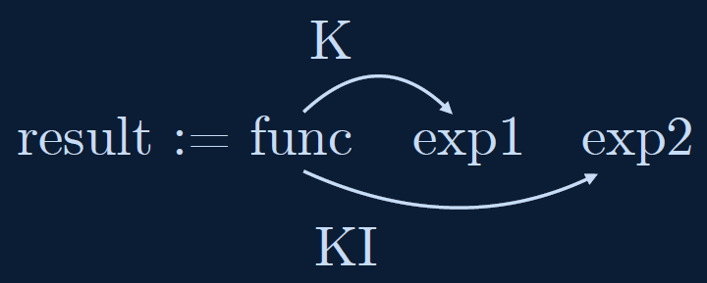
TRUE := K
FALSE := KI = C K

Slide 31
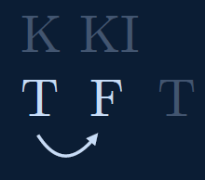
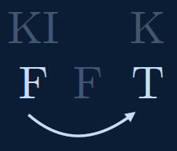
NOT
NOT := 𝜆p.pFT

Slide 32
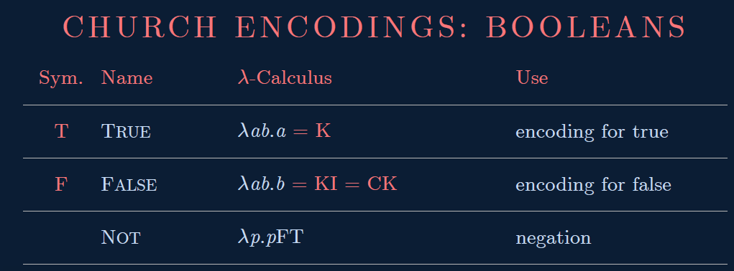

Slide 33
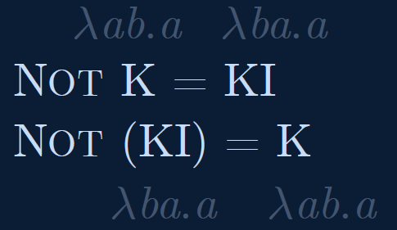
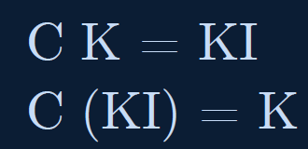
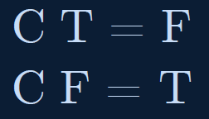

Slide 34
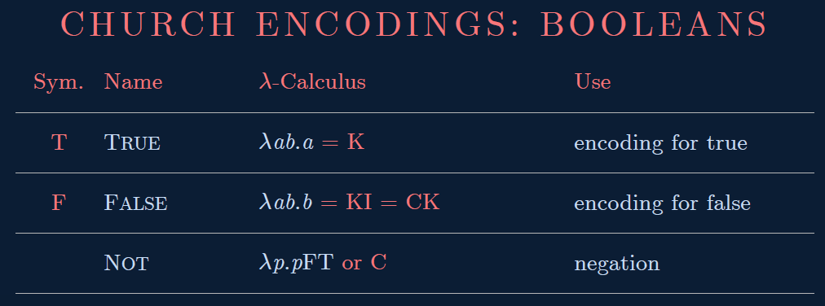

Slide 35
Church's Numerals
0 = λ f . λ x . x
1 = λ f . λ x . f x
2 = λ f . λ x . f (f x)
3 = λ f . λ x . f (f (f x))
4 = λ f . λ x . f (f (f (f x)))
λ f . λ x . (f (f (f (f x))))
4 a b
a (a (a (a b)))

Slide 36
Successor Function
succ = λ n . λ f . λ x . f (n f x)
0 = λ f . λ x . x
succ 0
(λ n . λ f . λ x . f (n f x)) 0
λ f . λ x . f (0 f x)
λ f . λ x . f ((λ f . λ x . x) f x)
λ f . λ x . f x
1 = λ f . λ x . f x
succ 0 = 1

Slide 37
Successor Function
succ = λ n . λ f . λ x . f (n f x)
1 = λ f . λ x . f x
succ 1
(λ n . λ f . λ x . f (n f x)) 1
λ f . λ x . f (1 f x)
λ f . λ x . f ((λ f . λ x . f x) f x)
λ f . λ x . f (f x)
2 = λ f . λ x . f (f x)
succ 1 = 2
succ n = n + 1

Slide 38
Addition
add 0 1 = 1
add 1 2 = 3
add = λ n . λ m . λ f . λ x . n f (m f x)
add 0 1
(λ n . λ m . λ f . λ x . n f (m f x)) 0 1
(λ m . λ f . λ x . 0 f (m f x)) 1
λ f . λ x . 0 f (1 f x)
λ f . λ x . 0 f (f x)
λ f . λ x . f x

Slide 39
Addition
add = λ n . λ m . λ f . λ x . n f (m f x)
add 1 2
(λ n . λ m . λ f . λ x . n f (m f x)) 1 2
(λ m . λ f . λ x . 1 f (m f x)) 2
λ f . λ x . 1 f (2 f x)
λ f . λ x . 1 f (f (f x))
λ f . λ x . (f (f (f x)))
3

Slide 40
Next classes
How to express
Combinators ✓
Boolean expression ✓
Numbers ✓
addition ✓
multiplication
recursion

